Slide 1


Augmented Reality in Navigation: Enhancing the Travel Experience
Augmented reality (AR) is revolutionizing the way we navigate our world. By seamlessly integrating digital information with the physical environment, AR navigation systems are transforming the travel experience, providing real-time guidance, contextual information, and immersive exploration.
by Mahitha Munjeti 22071A6736 – CSDS-A

Slide 2
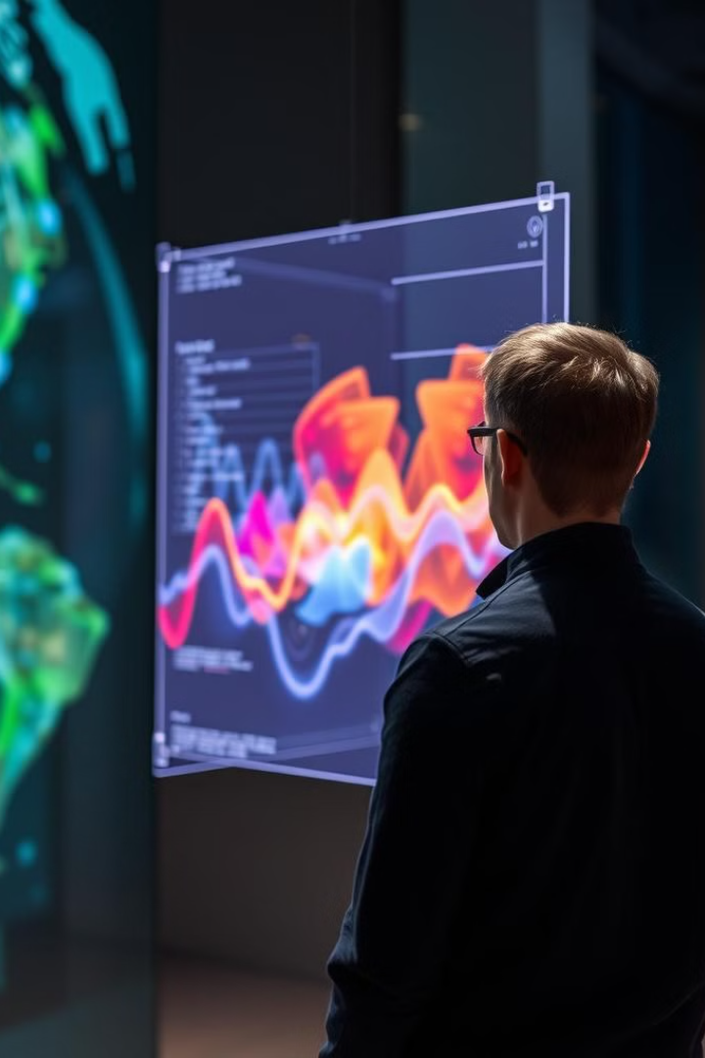
Introduction to Augmented Reality (AR)
1
Blending the Digital and Physical
2
Real-Time Interaction
AR systems respond to user input and movements, enabling dynamic and interactive experiences that blend the digital and physical realms.
AR technology superimposes computer-generated graphics, information, and 3D models onto the user's view of the real world, creating an enhanced perception of reality.
3
Diverse Applications
From gaming and retail to education and navigation, AR has a wide range of applications, transforming how we interact with and perceive our environment.

Slide 3

Evolution of Navigation Systems
Augmented Reality
Paper Maps
AR navigation overlays digital information and directions directly onto the user's view of the physical environment, enhancing spatial awareness and decision-making.
Traditional paper maps provided limited spatial awareness and required manual navigation.
1
2
3
GPS Navigation
Satellite-based GPS systems offered turn-by-turn directions and real-time location tracking.

Slide 4
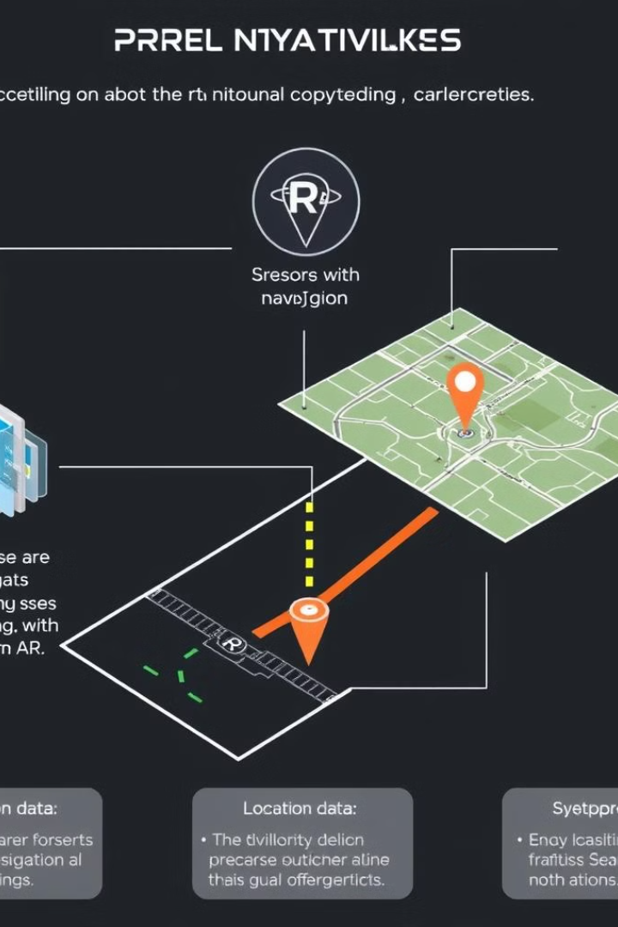
How AR Navigation Works
Sensor Integration
Spatial Mapping
AR navigation relies on a combination of sensors, including GPS, cameras, and motion trackers, to accurately locate the user and their surroundings.
The system maps the physical environment, creating a digital representation that can be overlaid with navigation data and virtual objects.
Real-Time Rendering
The AR interface dynamically renders directions, points of interest, and other digital content on top of the user's view, creating an immersive navigation experience.

Slide 5
Real-World Applications of AR in Navigation
Pedestrian Navigation
Automotive Navigation
Aviation and Maritime
AR navigation apps can provide walking directions, point out landmarks, and highlight nearby amenities, enhancing the urban exploration experience.
AR heads-up displays in vehicles can project navigation information directly onto the windshield, allowing drivers to keep their eyes on the road.
AR technology is transforming navigation for pilots and ship captains, providing enhanced situational awareness and real-time data overlays.

Slide 6
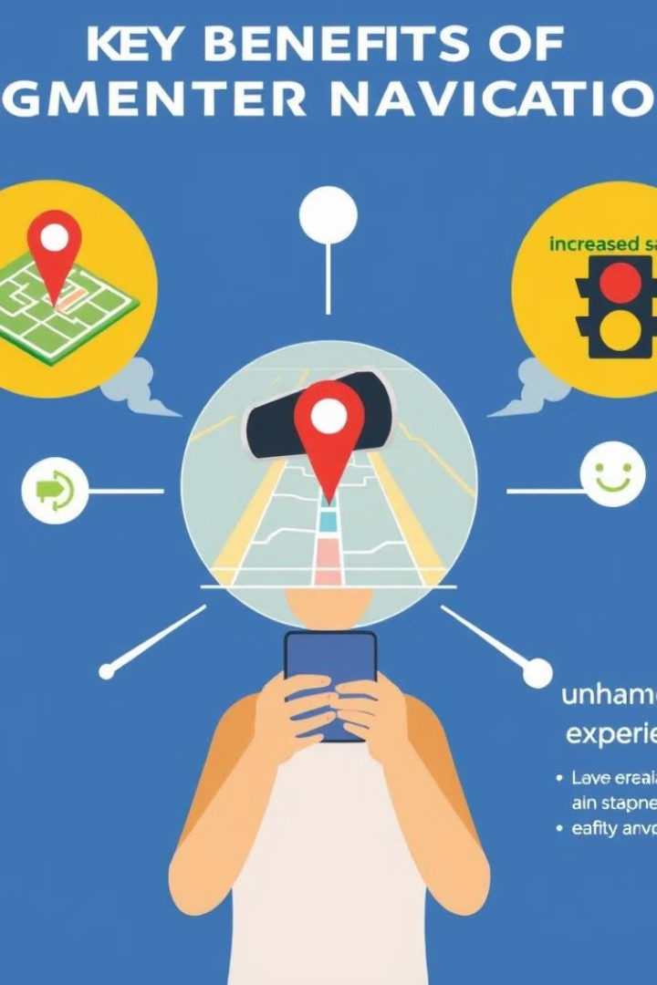




Benefits of AR Navigation
Improved Spatial Awareness
Increased Safety
AR navigation enhances the user's understanding of their surroundings by integrating digital information with the physical environment.
AR interfaces reduce the need for users to look away from their environment, keeping their attention focused on the road or path ahead.
Time Savings
Enhanced User Experience
AR navigation can provide more efficient routes and real-time updates, helping users reach their destinations faster.
The immersive and intuitive nature of AR navigation can make the travel experience more enjoyable and engaging.

Slide 7
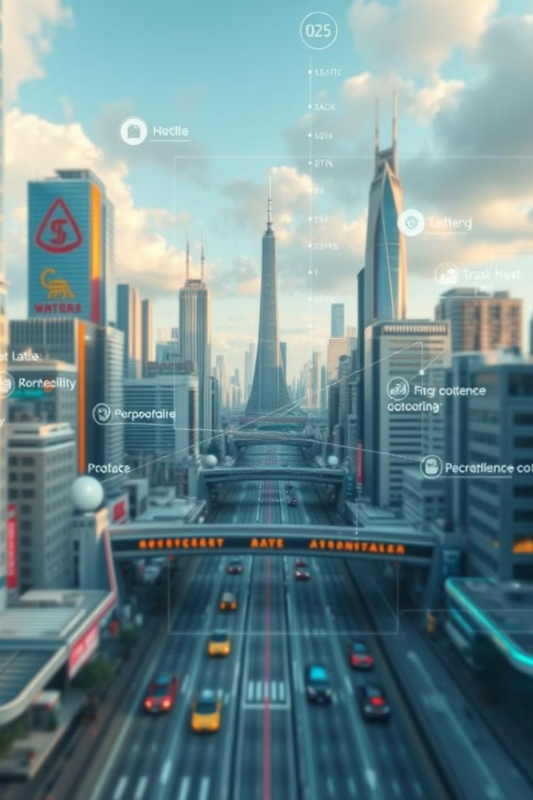
AR Navigation in Smart Cities
1
Traffic Optimization
AR navigation can help route users around congestion, construction, and other traffic incidents, improving overall city mobility.
2
Wayfinding and Exploration
AR can enhance the urban exploration experience by highlighting landmarks, points of interest, and providing turn-by-turn directions.
3
Integrated Information
AR navigation systems can seamlessly integrate with smart city infrastructure, providing users with real-time updates on public transportation, parking availability, and other city-related data.

Slide 8
AR in Autonomous Vehicles
Enhanced Situational Awareness
Improved Navigation
Collaborative Driving
AR navigation systems can seamlessly integrate with autonomous driving technology, providing real-time route guidance and optimizing the travel experience.
AR can enable communication and collaboration between autonomous vehicles, pedestrians, and infrastructure, enhancing overall safety and efficiency.
AR interfaces in autonomous vehicles can provide drivers with a comprehensive view of their surroundings, including nearby obstacles, pedestrians, and road conditions.

Slide 9
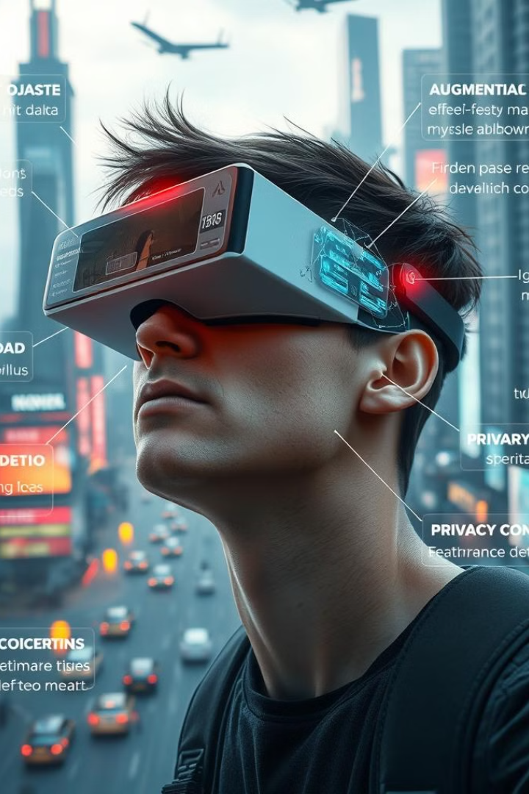



Challenges and Future of AR in Navigation
Technical Challenges
Improving accuracy, reliability, and battery life of AR systems are key hurdles to overcome for widespread adoption.
User Experience
Ensuring intuitive and seamless integration of AR into the navigation workflow is crucial for user acceptance and satisfaction.
Regulatory Considerations
Navigating the legal and ethical landscape surrounding the use of AR in transportation and public spaces will shape the future of this technology.

Slide 10
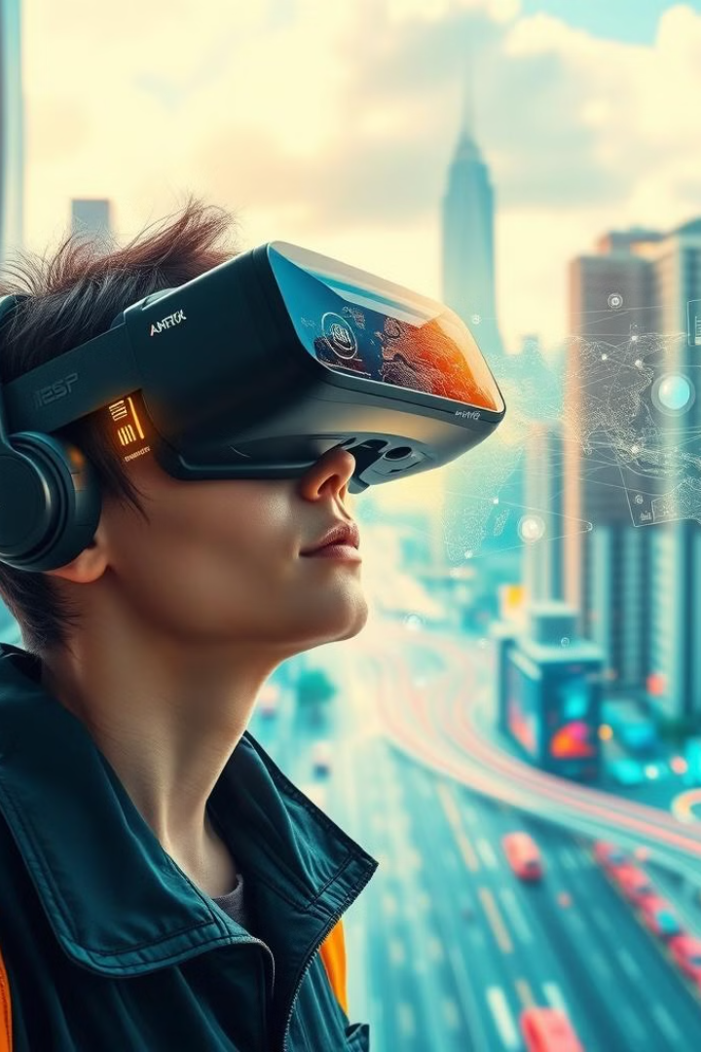
Conclusion
Augmented reality is poised to revolutionize the way we navigate our world, enhancing the travel experience with real-time guidance, contextual information, and immersive exploration. As this technology continues to evolve, it will unlock new possibilities for smarter, safer, and more efficient transportation solutions, transforming the way we interact with our environment.

Slide 11


